Slide 1
IST 652 Final project
Yelp Sentiment Analysis
Presenter: Yu Sheng Lu

Slide 2


Context
Yelp is a mobile app that help people find near by business
Often used to find restaurant
Reviews base on crowd source
Rating from 1~5 stars

Slide 3
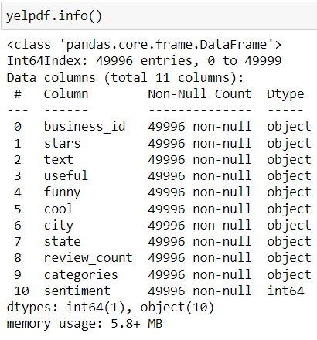
Importing Data
50000 entries
Yelp review and Yelp business json
Merge by business_id
There are total of 4 missing data and those were removed
Total data count will be 49996

Slide 4
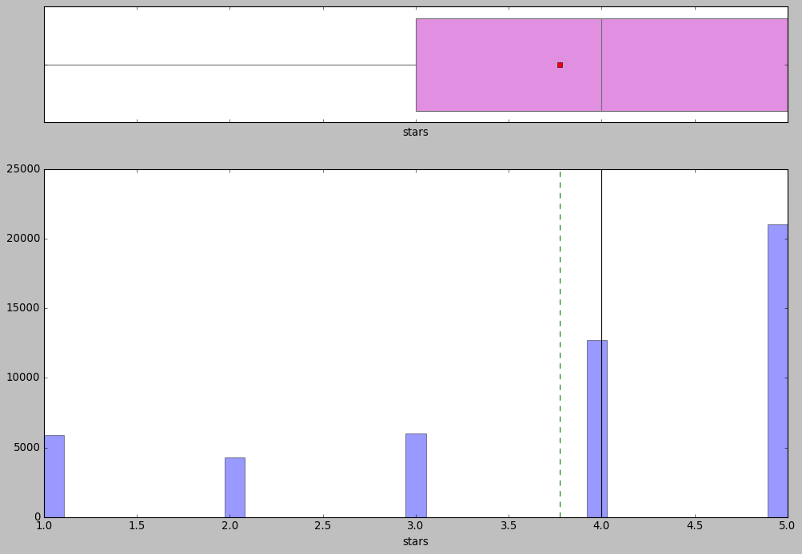
Exploratory Data Analysis for stars (rating)

Slide 5
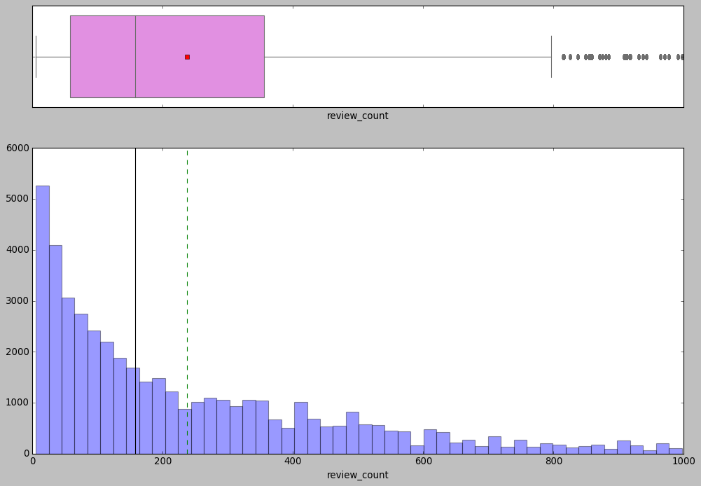
Exploratory Data Analysis for review count

Slide 6
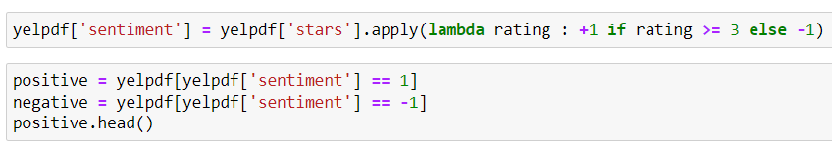
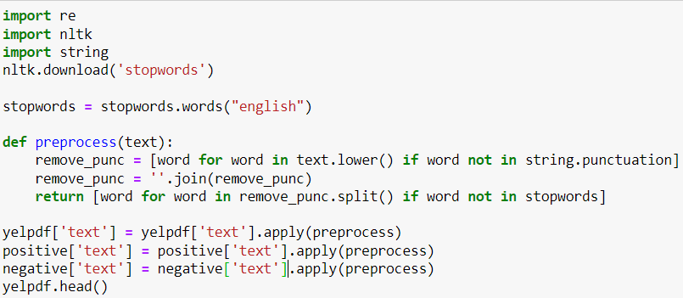
Data Preprocessing

Slide 7
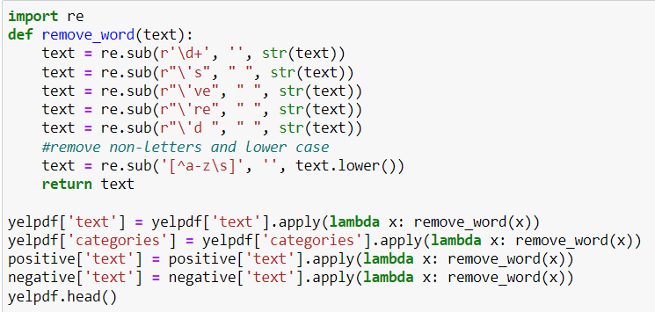
Data Preprocessing

Slide 8
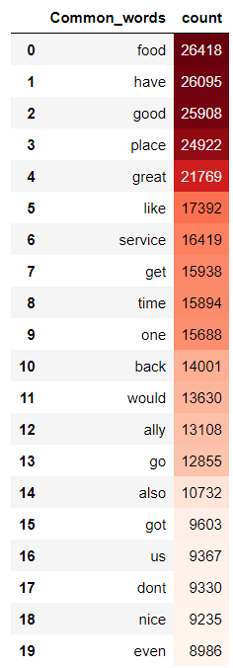
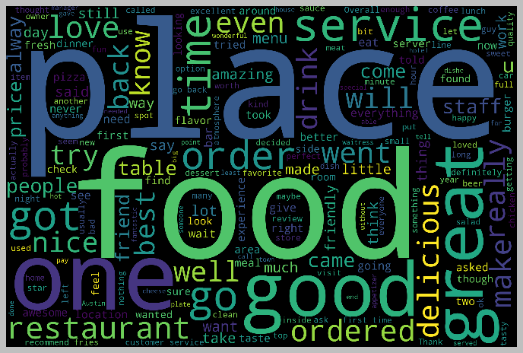
Word Cloud

Slide 9
Research Questions
What are the most used words for a good rating?
How often the positive word being use have a high rating?
What are the most used words for a bad rating?
How often the negative word being use have a low rating?
Which type of categories are the most among the datasets?

Slide 10
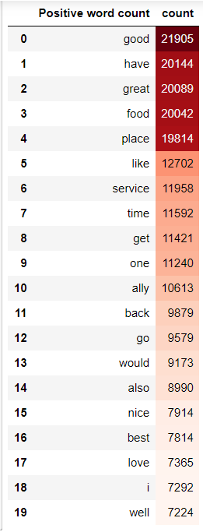
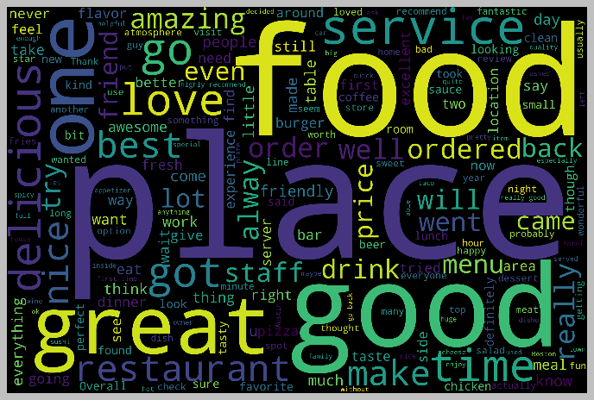
What are the most used words for a good rating?

Slide 11
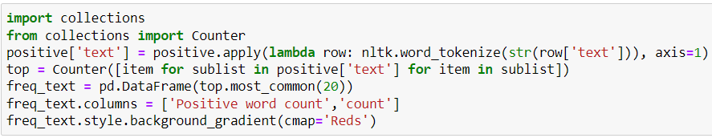







How often the positive word being use have a high rating?

Slide 12
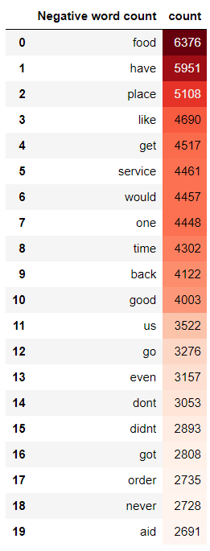
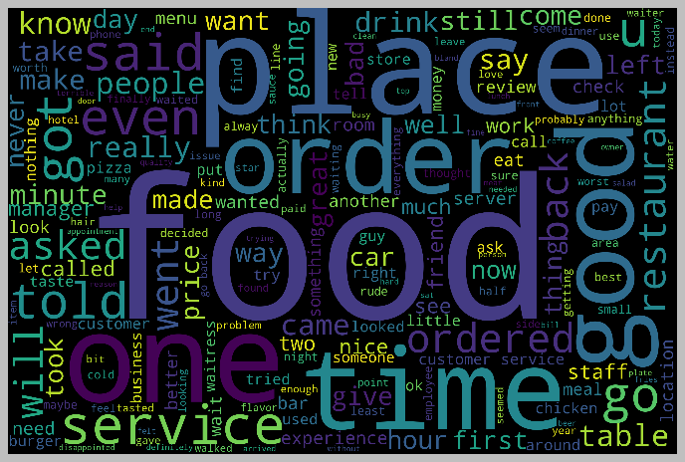
What are the most used words for a bad rating?

Slide 13
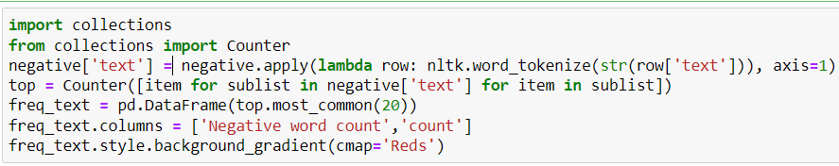



How often the negative word being use have a low rating?

Slide 14
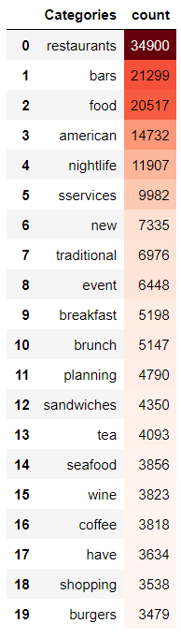
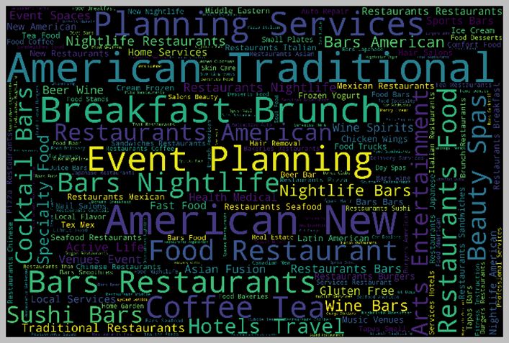
Which type of categories are the most among the datasets?

Slide 15


